Slide 1
Quality Circle Forum of India
presents
Problem Solving Techniques
- a simplified revised practical guide

Slide 2


Slide 3
What is Scatter Diagram?
Scatter Diagram is a graphical representation of relationship between two variables. It can be between a Cause and Effect and between two causes.
It also reveals the nature of relationship between two variables and their approximate strength.
ANGLE AFTER LAPPING
10 20 30 40 50 60 70 80 90
10 20 30 40 50 60 70 80 90
ANGLE BEFORE LAPPING

Slide 4
As said a Scatter diagram
is a graphical representation
of relationship
between two variables

Slide 5
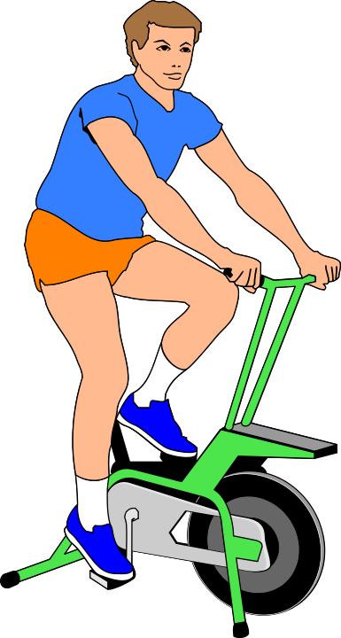



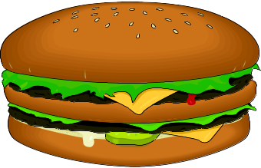
CAUSE EFFECT
Lack of exercise
OBESE
It can be a Cause and Effect relationship
Overeating

Slide 6
Overeating
Lack of exercise
It can also be between two causes

Slide 7

80
60
70
60
50
40
30
20
10
10 20 30 40 50
70
60
50
40
30
20
10
10 20 30 40 50 60 70 80
It is normally used to examine relationship before
proceeding for further analysis.

Slide 8

It is also used to find out the strength of relationship

Slide 9

Eighteenth Century is considered as the golden age of graphical methods.

Slide 10
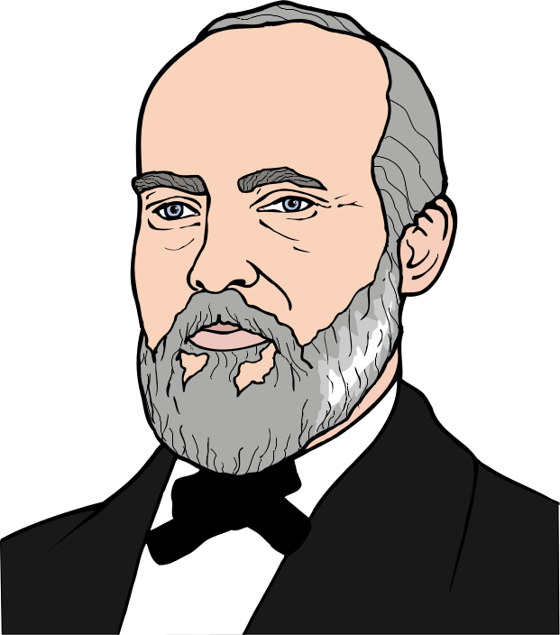
Dr.Buxton developed printed graph paper which spurred the uses of Scatter diagram

Slide 11
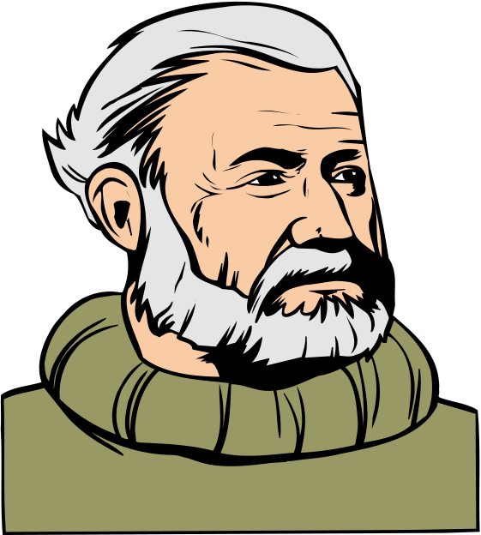
In 1837 J.F.W. Herschal, an Englishman, used Scatter diagram.

Slide 12

In 1950s Dr. K. Ishikawa popularised the use of Scatter Diagram

Slide 13
Circumference
Diameter
In our day to day life we can see exact relationship between two variables in very few cases like mathematical formula.

Slide 14
In most of the cases other influences like chance causes give the relationship a Scatter look. The strength of the relationship depends upon various factors.

Slide 15

This technique is useful for QC members and
Quality improvement teams.

Slide 16

Lets us gather Data.
80
60
70
60
50
40
30
20
10
10 20 30 40 50 60 70 80
When we theorise a cause for a symptom or an effect we can gather data and examine the possible nature of relationship and strength of the influence.

Slide 17
I assume that the problem is because of ---------------------------
This also helps to remove opinions which are not based on facts.

Slide 18
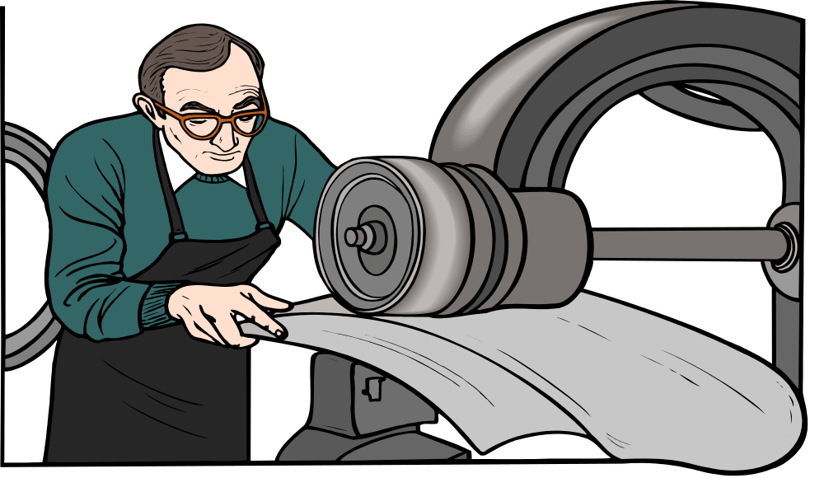
SEPTA RUBBER FACTORY
For example in a rubber factory, the occurrence of a particular defect was attributed to use of higher quantity of process oil.

Slide 19

Since it was a serious problem, the compounder decided to examine the relationship.

Slide 20

First he made batches with different levels of oil usage. He put them into use and collected data on the particular defect.

Slide 21
S.No OIL LEVEL (PHR) NO. OF DEFECTIVES
1.
2.
3.
4.
5.
-
-
-
25
2 17
2 5
2.5 32
3 6
3 23
4 3
The data was paired i.e. oil level and number of defectives.

Slide 22
DEFECT LEVEL
LEVEL OF OIL
He plotted them in a graph i.e. in 'Y' axis the defect level and in 'X' axis the level of oil used. This showed that there was no correlation between the two variables.

Slide 23
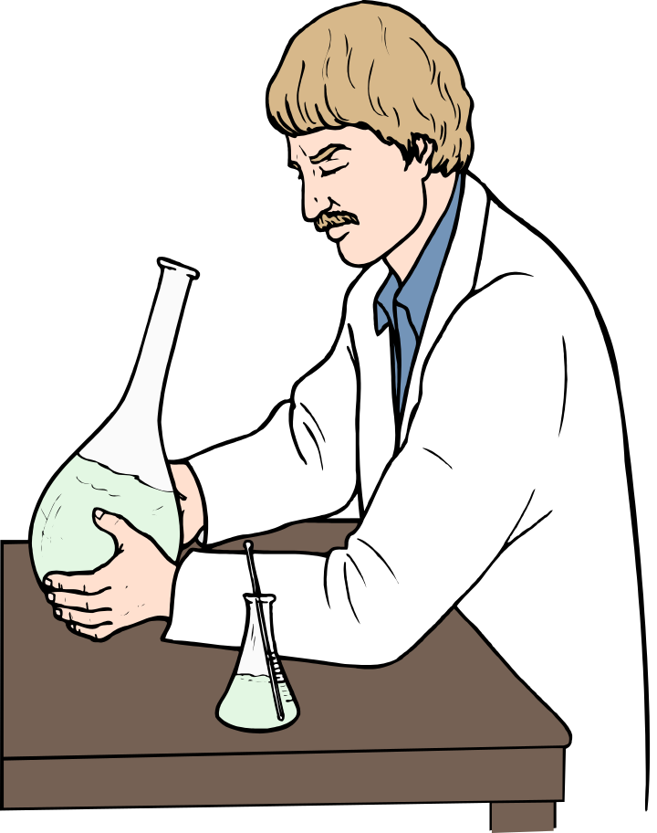
Then he concentrated on other aspects and came to the use of a resin. Here he tried the test i.e. using different proportion of resin in the batches.

Slide 24
DEFECT LEVEL
LEVEL OF RESIN
He collected data on number of defectives in relation to resin proportion and plotted in a Scatter Diagram. This showed a positive correlation, thus establishing the cause.

Slide 25
This illustrates few important points such as necessity of establishing true relationship between cause and effect before proceeding further.

Slide 26
Cause and effect relation shows variation according to the intensity.

Slide 27
A few examples of cause and effect relation are
Cause
Effect
Rash Driving Accident
Jumping from 10,000 feet Death
Consuming Potassium Cyanide Instant Death
Overeating Over weight
Too much work Dull Mind
Watching too much T.V. Failing in exams

Slide 28
How to make a Scatter diagram?
Let us say that we are interested in finding out the orientation angle (measure) before and after lapping in quartz crystal unit.

Slide 29
Orientation Angle ( In minutes ) before & after lapping in quartz crystal unit
No After Before
No After Before
No After Before
No After Before
1 37 36
2 41 39
3 41 45
4 42 46
5 44 44
6 47 48
7 48 51
8 51 57
9 53 42
10 55 47
11 46 48
12 47 48
13 58 55
14 58 58
15 53 49
16 54 46
17 46 48
18 67 69
19 71 68
20 70 72
21 71 73
22 76 77
23 80 70
24 71 73
Collect 30 - 40 paired samples of data to examine the relationship

Slide 30
ANGLE AFTER LAPPING
ANGLE BEFORE LAPPING
Draw the 'X' and 'Y' axis and mark the values. It is normal practice to write the cause value (called independent variable) on the 'X' axis and effect (called dependent variable) on 'Y' axis.

Slide 31
.
.
.
.
.
ANGLE AFTER LAPPING
10 20 30 40 50 60 70 80 90
10 20 30 40 50 60 70 80 90
ANGLE BEFORE LAPPING
Plot the data on the graph

Slide 32
.
.
.
.
ANGLE AFTER LAPPING
.
10 20 30 40 50 60 70 80 90
.
10 20 30 40 50 60 70 80 90
ANGLE BEFORE LAPPING
If the value is repeated and fall on the same point make concentric circle

Slide 33
ANGLE AFTER LAPPING
10 20 30 40 50 60 70 80 90
10 20 30 40 50 60 70 80 90
ANGLE BEFORE LAPPING
If the emerging picture is something like this we say that there is positive relationship or positive correlation.

Slide 34
ANGLE AFTER LAPPING
10 20 30 40 50 60 70 80 90
10 20 30 40 50 60 70 80 90
ANGLE BEFORE LAPPING
If the picture is slightly spread like this then we say that there is a possibility of positive correlation.

Slide 35
ANGLE AFTER LAPPING
10 20 30 40 50 60 70 80 90
10 20 30 40 50 60 70 80 90
ANGLE BEFORE LAPPING
If it is like this we can say that there is 'no correlation' between them.

Slide 36
ANGLE AFTER LAPPING
10 20 30 40 50 60 70 80 90
10 20 30 40 50 60 70 80 90
ANGLE BEFORE LAPPING
Sometimes an emerging diagram can be like this, then we can say that there is a possibility of negative correlation.

Slide 37
ANGLE AFTER LAPPING
10 20 30 40 50 60 70 80 90
10 20 30 40 50 60 70 80 90
ANGLE BEFORE LAPPING
If it is like this we can say that there is a negative relationship or negative correlation between the two variables.

Slide 38
ANGLE AFTER LAPPING
10 20 30 40 50 60 70 80 90
10 20 30 40 50 60 70 80 90
ANGLE BEFORE LAPPING
Sometime we may have Scatter like this also i.e. positive correlation up to certain level and then negative.

Slide 39
ANGLE AFTER LAPPING
10 20 30 40 50 60 70 80 90
10 20 30 40 50 60 70 80 90
ANGLE BEFORE LAPPING
It can be vice versa also i.e negative correlation up to one level and then positive.

Slide 40

There is another way of making Scatter diagram which is called a Correlation table.

Slide 41
Here make vertical and horizontal columns as shown . This is based upon the data.

Slide 42
80
70
60
50
40
30
Write down the values as shown here.

Slide 43
80
70
60
50
40
30
30 40 50 60 70
Then mark the readings in appropriate column as shown here.

Slide 44
I
80
70
60
50
40
30
I
IIII
II
II
II
IIII
I
IIII
I
I
30 40 50 60 70
Put tally marks in the appropriate cell.

Slide 45
2 6 8 3 5
80
70
60
50
40
30
I
1
5
4
7
6
1
I
IIII
II
II
II
IIII
I
IIII
I
I
30 40 50 60 70
Once all values are entered compute the row and column totals.

Slide 46
2 6 8 3 5
80
70
60
50
40
30
I
1
5
4
7
6
1
I
IIII
II
II
II
IIII
I
IIII
I
I
30 40 50 60 70
Emerging picture also will give an idea about the relationship.

Slide 47

How to find out the approximate strength of the correlation ?

Slide 48
This can be found out by using a formula.
Procedure is as follows:

Slide 49
Take sample of observation for the two variables under study.
'Data on Hardness and Tensile strength of copper alloy casting'
Test Piece Hardness Tensile Strength
1 84 38.0
2 93 40.7
3 89 35.3
4 86 37.6
5 87 33.1
6 93 24.9
7 88 28.3

Slide 50
2
Find out the value of X i.e 84X84 = 7056
93X93 = 8849
and so on

Slide 51
2
Find out the value of Y i.e 38X38 = 1444
40.7X40.7 = 1656.49
and so on

Slide 52
Find out the 'XY'value of observation ie
84X38 = 3192
93X40.7 = 3785.1
and so on

Slide 53
2
2
No. X Y XY
1. 7056 1444.00 3192.0
2. 8649 1659.49 3785.1
3. 7921 1246.09 3141.7
4. 7396 1413.76 3233.6
5. 7569 1310.44 3149.4
6. 8649 1413.76 3496.8
7. 7744 1095.61 2912.8

Slide 54
Step 1
Find out 'n' and obtain total of
X, Y, X, Y and 'XY'
n = 25
Σx = 2147
ΣY = 899.7
ΣX = 185597
ΣY = 32715.29
ΣXY = 77749.20
2
2
2
2

Slide 55
Step 2
Simplified formula for co-efficient of correlation
Σ xy - (Σx) (Σy)
n
r =
2
2
2
2
{ Σ x - (Σx) }
{ Σ y - (Σy) }
n
n

Slide 56
Step 3
Substitute the values in the formula
77749. 2 − (2147) (899.7)
25
r =
2
2
{185597 − (2147) }
{32715.29 − (899.7) }
25
25

Slide 57
Step 4
Find out the value of ‘r’. If the 'r' value is above 0.7, then the correlation is useful.
483
r =
639.15
r = 0.7557

Slide 58
Step 5
2
Find out 100 r.
This gives percentage of variation in 'Y' influenced by 'X' i.e the independent variable. In this case
100r 57.1
2
=

Slide 59
Step 5
Therefore correlation between these two variables is useful.
r 0.5710
100 r 57.10
2
=
2
=

Slide 60

Assessing correlation with scatter diagram.
We will see here a method called
'Median method'

Slide 61
ANGLE AFTER LAPPING
10 20 30 40 50 60 70 80 90
10 20 30 40 50 60 70 80 90
ANGLE BEFORE LAPPING
Take a scatter diagram where the values are already plotted.

Slide 62
~
x
ANGLE AFTER LAPPING
10 20 30 40 50 60 70 80 90
10 20 30 40 50 60 70 80 90
ANGLE BEFORE LAPPING
First find out the median of 'X' i.e count the dots across and when you complete half the number, mark a straight line parallel to 'Y' axis.

Slide 63
~
x
10 20 30 40 50 60 70 80 90
ANGLE AFTER LAPPING
~
y
10 20 30 40 50 60 70 80 90
ANGLE BEFORE LAPPING
Same way count the dots bottom to top and when you complete half the number mark a straight line parallel to 'X' axis.

Slide 64
~
x
( II )
( I )
ANGLE AFTER LAPPING
10 20 30 40 50 60 70 80 90
~
y
( III )
( IV )
10 20 30 40 50 60 70 80 90
ANGLE BEFORE LAPPING
Mark the 4 quarters in 'Anti clock wise' direction as shown in the figure as Area I, Area II, Area III and Area IV.

Slide 65
Count the dots in each quarter and write down in the appropriate column
QUADRANT POINTS
I 19
II 4
III 20
IV 5
On the line 2

Slide 66
Find number of points for II and IV and 'N' (i.e total number of dots made minus number of points on the line)
Number of points in II & IV is 4+5 = 9
and
N = 50 - 2 = 48

Slide 67
Compare the total number of points in
II and IV with the
"limit of number of points"
column indicated in
Sign test Table .
If the number of points of the two areas
is less than the limit numbers shown, then we can say that a correlation exists.

Slide 68
Compare the total number of points in
II and IV with the
"limit of number of points"
column indicated in
Sign test Table .
If the number of points of the two areas
is less than the limit numbers shown, then we can say that a correlation exists.

Slide 69
Sign Test Table
N Limit of Number of N Limit of Number of
Points for I+III, II+IV Points for I+III, II+IV
20 5 42 14
21 5 44 15
22 5 46 15
23 6 48 16
24 6 50 17
25 7 52 18
26 7 54 19
27 7 56 20
28 8 58 21
29 8 60 21
30 9 62 22
32 9 64 23
34 10 66 24
36 11 68 25
38 12 70 26
40 13
Note: This table is limited to N=20 to 70 at a 5 per cent level of significance.
When N=48, the point number limit is 16. As 16 > 9, a positive correlation exists.

Slide 70
PITFALLS

Slide 71
( a )
( b )
60
70
60
50
40
30
20
10
50
40
30
20
10
No correlation
Positive correlation
10 20 30 40 50 60 70 80
10 20 30 40 50 60 70 80
Certain precautions are needed while making Scatter diagram. One of them is using proper scale. In the above picture 'a' paired data is depicted in proper scale, where as in 'b' vertical scale is made with 50% scale of 'a'. See the difference.

Slide 72
Positive correlation
Possibility of a positive correlation
( a )
80
60
70
60
50
40
30
20
10
80
60
70
60
50
40
30
20
10
( b )
10 20 30 40 50 60 70 80
10 20 30 40
Similarly here horizontal scale is double of the scale of 'a'. See the difference.

Slide 73
( a )
( b )
No correlation
Positive correlation
80
60
70
60
50
40
30
20
10
80
60
70
60
50
40
30
20
10
10 20 30 40 50 60 70 80
10 20 30 40 50 60 70 80
Please ensure that there is no data mix up. See the diagram 'a' which is with data mix up and 'b' is stratified. In 'a' there is no correlation but 'b' shows correlation.

Slide 74
( A )
Positive correlation
80
60
70
60
50
40
30
20
10
10 20 30 40 50 60 70 80
Similarly mix up data at times give deceptive correlation as shown here. Look at (A) with mix up data showing correlation.

Slide 75
No correlation
( B )
80
60
70
60
50
40
30
20
10
10 20 30 40 50 60 70 80
When stratified as shown in 'B' the same data do not show any correlation.

Slide 76
( A )
80
60
70
60
50
40
30
20
10
10 20 30 40 50 60 70 80
Look at the figure 'A' shown above. You can see as 'X' increases 'Y' takes a curved path.

Slide 77
Now divide the data as shown in ‘b’

Slide 78
( A )
( B )
Positive correlation
Negative correlation
80
60
70
60
50
40
30
20
10
80
60
70
60
50
40
30
20
10
10 20 30 40 50 60 70 80
10 20 30 40 50 60 70 80
Here, in the divided data of previous diagram you can see a distinct positive and negative correlation respectively in the diagram.

Slide 79
From the examples shown above we can conclude that:
Data should be properly stratified and Mixed data will give misleading results.

Slide 80
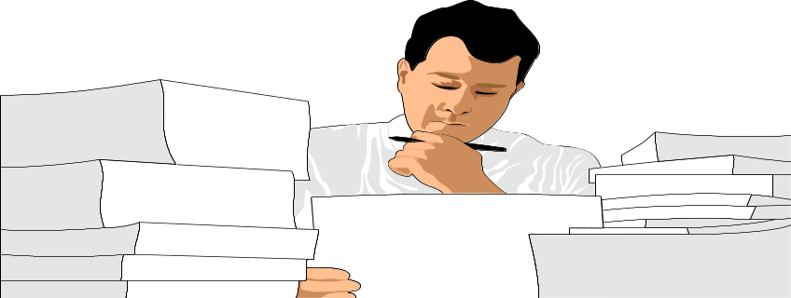
No After Before
No After Before
No After Before
No After Before
1 37 36
2 41 39
3 41 45
4 42 46
5 44 44
6 47 48
7 48 51
8 51 57
9 53 42
10 55 47
11 46 48
12 47 48
13 58 55
14 58 58
15 53 49
16 54 46
17 46 48
18 67 69
19 71 68
20 70 72
21 71 73
22 76 77
23 80 70
24 71 73
Data should be collected for full range.

Slide 81
10 20 30 40 50 60 70 80
10 20 30 40 50 60 70 80 90
As we know sometimes there can be a positive correlation up to a level then negative correlation.

Slide 82
10 20 30 40 50 60 70 80
10 20 30 40 50 60 70 80 90
If information is not complete and is only up to the level of positive correlation then it will give a wrong idea.

Slide 83

Data collected also should be within the scope of the process. Outside that may also give wrong results.

Slide 84

The Diagram you have prepared may give you the wrong idea, because the scale used on the X - axis is not proper.
80
60
70
60
50
40
30
20
10
10 20 30 40 50
While plotting, right scale should be used for graph. Wrong scale gives wrong picture.

Slide 85

Data collected does not make sense !!!
Data collected should be free from bias and/or undue importance. Sometimes some other factor may play an important role. Data collected at that time is useless.

Slide 86

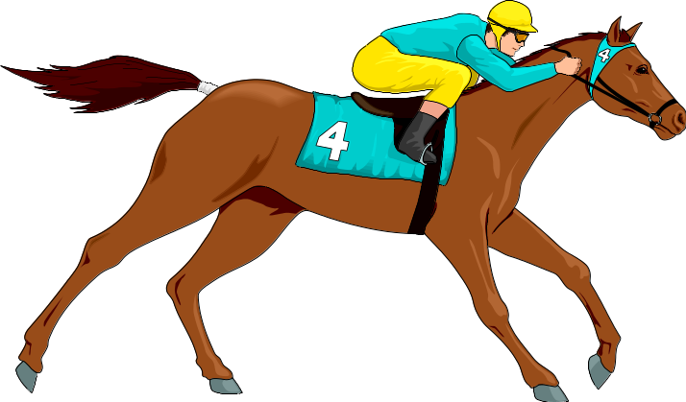
Eg: Whenever I wear a red suit I win money in the race.
MAHALAKSHMI
RACE COURSE
There should be an expectation of correlation. One should not try to establish correlation between irrelevant factors.

Slide 87
Need for a good Scatter diagram.

Slide 88

A possible correlation or a right assumption.

Slide 89
Collect data properly. Data should be in pairs. For example, height and weight should be of the same individual.

Slide 90

Data collected should be correctly recorded.

Slide 91

The information should be complete spreading over a process.

Slide 92
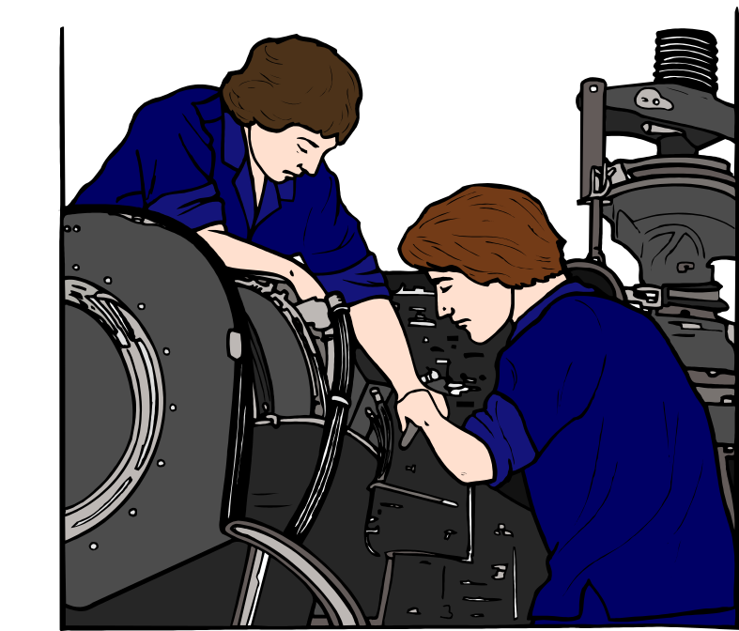
80
60
70
60
50
40
30
20
10
10 20 30 40 50 60 70 80
It should be a truly representative sample. Sample should represent the actual condition and situation in the process.

Slide 93
If relationship is established, then it can be used for prediction purposes or for controlling the variation of dependent variable ‘y’.

Slide 94
SUMMARY
Scatter Diagram helps to find out the relationship between two variables which can be a cause and effect or between two causes.
There are computational methods to find out the strength of correlation or degree of correlation using a formula.

Slide 95
SUMMARY
The correlation can be identified as positive and/or negative after plotting the pairs of data.
Scatter diagram is useful to find out the root cause of a problem.
There are certain precautions to be taken while making Scatter diagram.

Slide 96

Prepared by
G. Vijaykumar

Slide 97


